Slide 1
Bank Marketing

Slide 2
AGENDA
Introduction to Project
Problem Statement
Data Preparation
Data Analysis
Model Building
Result and Assessment

Slide 3
Introduction
What is Bank Marketing.
Why this Project.
Expectations from Project
Who will benefit and how

Slide 4
PROBLEM STATEMENT
To optimize bank marketing strategy and improve effectiveness. Understanding customer needs relates to more customer marketing plan. Based on the prediction, the bank will invest further and helps in their revenue.
Problem Motivation : By using such a predict algorithm, the bank can better target its customers and better channelize it’s marketing efforts.
Banks offered their clients fixed-term deposit. Data was collected about each client, type of contact, and outcome.

Slide 5
Objective
To increase the effectiveness of the Bank’s tele marketing campaign.
This project enables the bank to develop a more granular understanding of the customer base. Predict the customer’s response to telemarketing campaign.

Slide 6
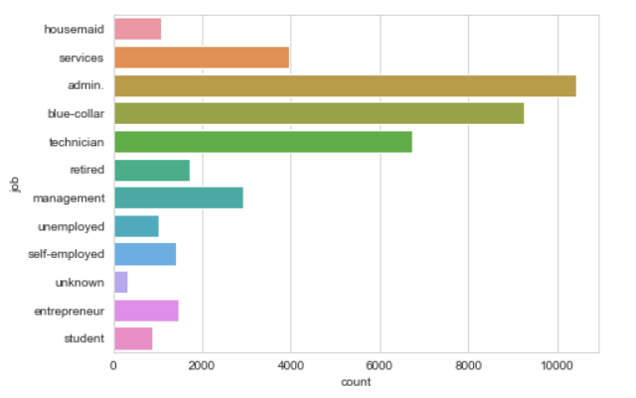
DATA EXPLORATION
Tools Used – Jupyter Notebook
Exploratory Data Analysis:
All coding is done in python 3.
Extensive use of pandas, numpy, matplotlib, as well as seaborn and sklearn packages.
Dataset contained 21 different features on more than 41,000 clients.
Features were both categorical and numerical. Target variable is binary(“Yes”, or “No”).

Slide 7
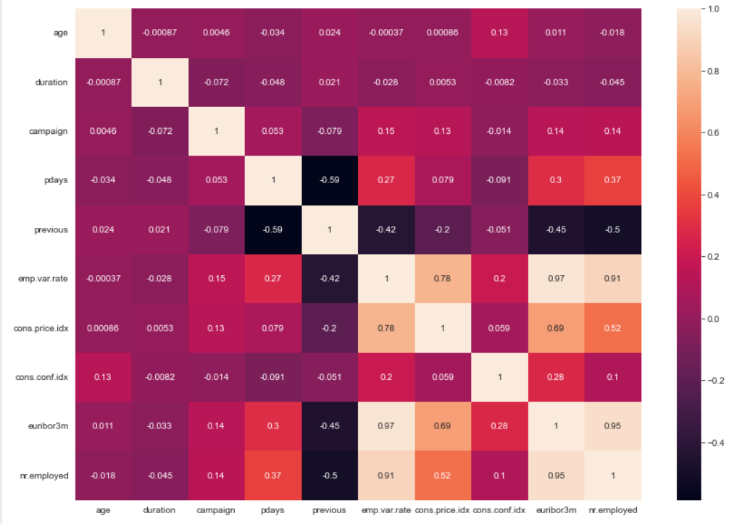
DATA PREPARATION
Many features had missing values.
Heatmap is plotted to show strong correlations between the features.

Slide 8
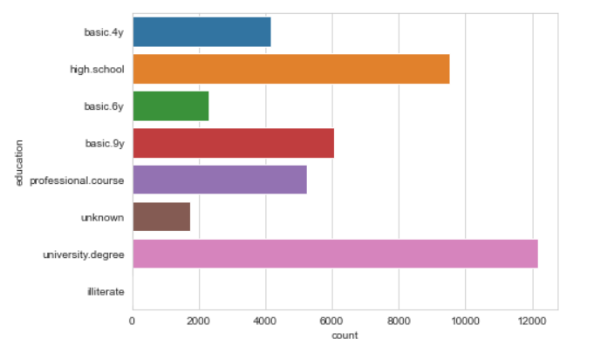
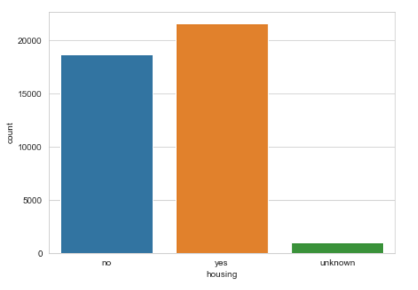
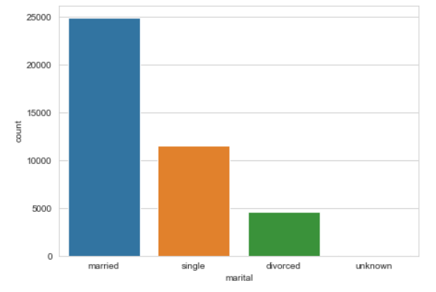
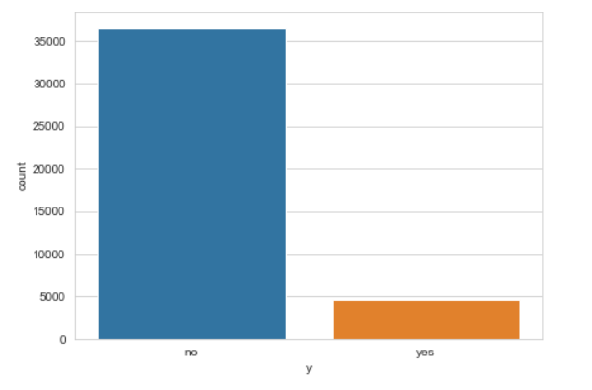
Plots for Categorical Data

Slide 9
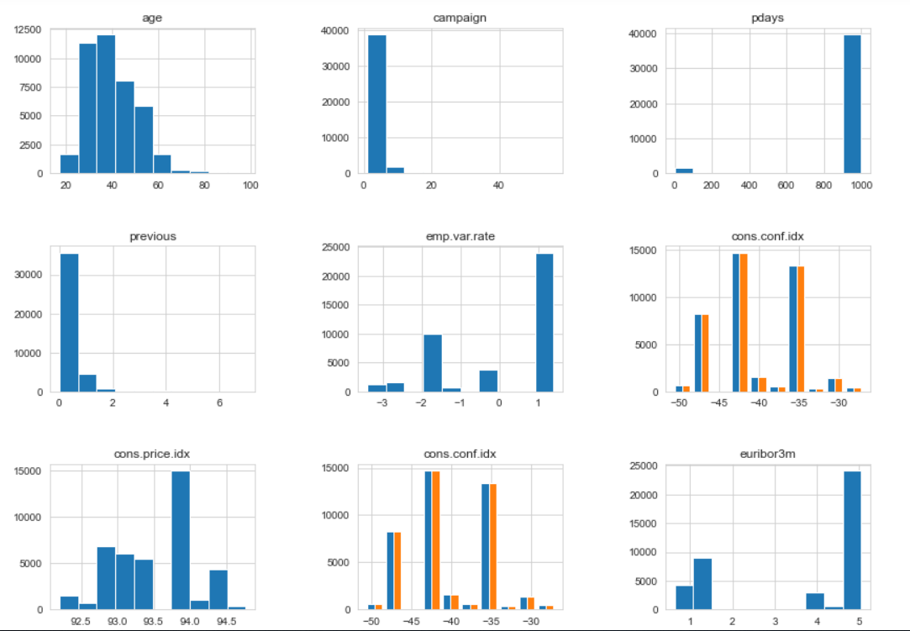
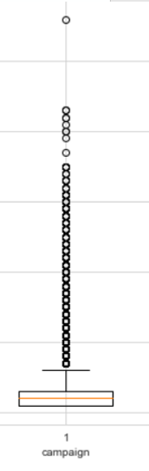
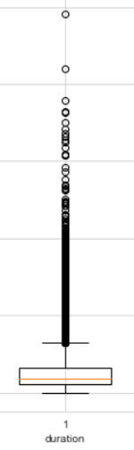
Visualizations for Numerical Data

Slide 10
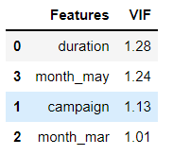
Model Building
Logistic Regression Model is used.
Dataset is divided into training data and test data.
With the intension of using the training data to find the parameters of the particular model being used(fitting the model on the training data) and then applying this to the test data to determine the model’s performance.
And to draw conclusions about it’s predictive capability.
Feature selection:
Significant features are detected and selected using various methods during model building:
1. Recursive Feature Elimination.
2. Variance inflation factor

Slide 11
Model Evaluation
Model’s Algorithm is evaluated based on different metrics, here we have used:
1. Accuracy score
2. Recall/ / sensitivity
3. ROC curve/ rate
Logistic Regression achieved an accuracy of about 86%, suggesting high level of strength of this model to classify the customer response given all the defined customer features.

Slide 12
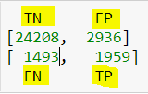
Result
Accuracy score for selected feature using logistic regression model is 86%.
Recall score for selected feature using logistic regression model is 56%.
ROC/ R2 score is 85%.
Confusion Matrix:

Slide 13
Recommendation
Try to engage customers and have longer calls
Preferably use Telephone as the mode of contact.
Prioritize those customers to who were part of the previous marketing campaigns.

